Slide 1
California Workers’ Retirement Income Prospects
Nari Rhee, PhD
UC Berkeley Center for Labor Research and Education
California Commission on Aging Elder Economic Forum:
Political, Economic, and Demographic Impacts on Retirement
November 19, 2019
Los Angeles, CA

Slide 2
California’s Triple Challenge
Aging
Inequality and the sagging middle: worse in CA than the US as a whole
Increasing share of seniors from populations that have had less opportunity to build retirement assets, i.e., immigrants and workers of color

Slide 3
Overview of Retirement Resources
Social Security
average CA benefit $17,190/yr or $1,430/mo
Housing wealth
declining home ownership rates among seniors, more prevalent mortgage debt
Savings & Pensions
Typical CA worker has negligible retirement savings
Bottom line: typical older household has about half the private wealth they need to bridge the gap between Social Security and total retirement income need.

Slide 4
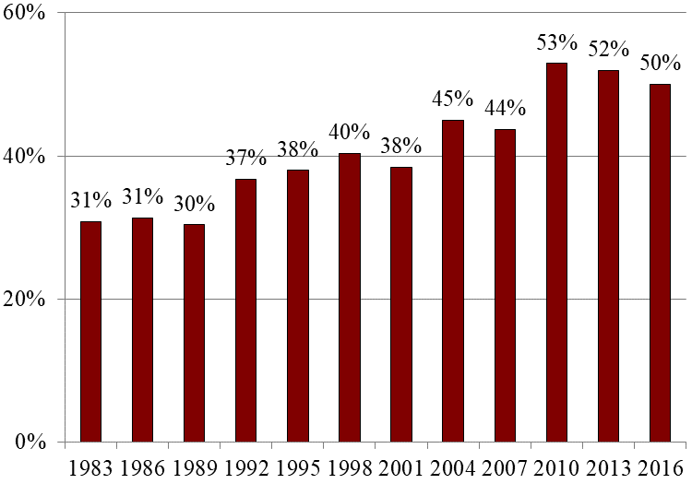
Nationally, 1/2 of Working-Age Households Face Downward Mobility in Retirement
National Retirement Risk Index, 1983-2016
Source: Munnell, Hou, & Sanzenbacher, “National Retirement Risk Index Shows Modest Improvement in 2016,” Center for Retirement Research, 2018

Slide 5
Racial Wealth Gap (US)
Table 1. Median Net Wealth (in 2016 Dollars) by Race/Ethnicity, 2007-2016
Race/ethnicity | 2007 | 2010 | 2013 | 2016
 | Level
White | $183,100 | $113,400 | $106,000 | $132,100
Black | 39,000 | 18,500 | 13,300 | 18,300
Hispanic | 59,300 | 21,800 | 17,700 | 24,400
 | Ratio
White/Black | 4.7 | 6.1 | 8.0 | 7.2
White/Hispanic | 3.1 | 5.2 | 6.0 | 5.4
Sources: Authors' calculations from the SCF (2007-2016).
Source: Munnell, Hou, & Sanzenbacher, “Trends in Retirement Security by Race/Ethnicity,” Center for Retirement Research, 2018.

Slide 6
Majority of private sector workers of all races, including 7 out of 10 Latinos, lack access to workplace retirement plans
Source: N. Rhee, “Half of California Private Sector Workers Have No Retirement Assets,” UC Berkeley Center for Labor Research and Education, 2019.

Slide 7
About half of private sector workers in CA have no IRA, 401(k), or pension
Source: N. Rhee, “Half of California Private Sector Workers Have No Retirement Assets,” UC Berkeley Center for Labor Research and Education, 2019.

Slide 8
3 out of 4 low-income workers and half of middle-income workers have no retirement assets
Source: N. Rhee, “Half of California Private Sector Workers Have No Retirement Assets,” UC Berkeley Center for Labor Research and Education, 2019.

Slide 9
Typical older household in CA has half the private wealth they need to retire with adequate income.
Source: N. Rhee, “Half of California Private Sector Workers Have No Retirement Assets,” UC Berkeley Center for Labor Research and Education, 2019.

Slide 10
Women Face Multiple Challenges
Recent parity in workplace retirement plan access, but…
Lower salaries than men
Earning/saving careers interrupted & shortened at both ends by unpaid caregiving
Longer life expectancy after retirement
More likely to be poor in old age

Slide 11
What about earnings?
Increasing senior labor force participation
Employment bifurcated between elite professional jobs and low-wage service jobs, with missing middle
Downward pressure on wages incl. age discrimination, less geographic mobility
Result: downward mobility for retiring middle class workers

Slide 12
Policy Considerations
Boosting retirement income
CalSavers (auto-IRA) for private sector workers – mostly benefits young and mid-career workers
For older workers, goal should be to delay Social Security through savings and, if possible, earnings
Need to continue statewide and national conversation on improving retirement income security: Social Security, expanding pension coverage
Long term care insurance – eg WA social insurance model
Safety net for immigrant/undocumented elders who lack access to Social Security and other programs

